Slide 1
Secure Data Hiding in Image Using Steganography
CAPSTONE PROJECT
Presented By :
Student Name : Harshit Goel
College Name & Department : University of Petroleum and Energy Studies (UPES, Dehradun) – School of Computer Science (SoCS)

Slide 2
OUTLINE
Problem Statement
Technology used
Wow factor
End users
Result
Conclusion
Git-hub Link
Future scope

Slide 3
Problem Statement
With growing security concerns, traditional encryption may not always be enough to protect sensitive data. This project focuses on image steganography, a method that hides text inside images by slightly changing pixel values. The goal is to create an easy-to-use steganography tool for hiding and retrieving secret messages, ensuring safe and hidden communication.

Slide 4
Technology used
Programming Language:
Python – For implementing steganography algorithms.
HTML, CSS, JavaScript – For the frontend interface.
Libraries & Frameworks:
OpenCV – For image processing.
NumPy – For handling image arrays.
PIL (Pillow) – For working with images.
Platforms & Tools:
VS Code – For writing and testing the code.
GitHub – For version control and project management.

Slide 5
Wow factors
Dual-Layer Security – Hides messages inside images, making them invisible for added security.
User-Friendly Web Interface – Built with HTML, CSS, and JavaScript, making it accessible and easy to use.
Customizable Image Selection – Users can choose any image for embedding hidden messages.
Minimal Image Distortion – The algorithm ensures that changes are undetectable to the human eye.
Fast Encoding & Decoding – Powered by Python, OpenCV, NumPy, and Pillow for quick processing.
Cross-Platform Compatibility – Works on any device with a web browser.

Slide 6
End users
Cybersecurity Professionals – For secure communication and data protection.
Journalists & Activists – To secretly share sensitive information in restrictive environments.
Businesses & Organizations – To safeguard confidential documents and messages.
Forensic Experts – To analyze and detect hidden data in digital forensics.
Students & Researchers – For learning and experimenting with steganography techniques.
Privacy-Conscious Individuals – To keep personal information hidden from unauthorized access.

Slide 7
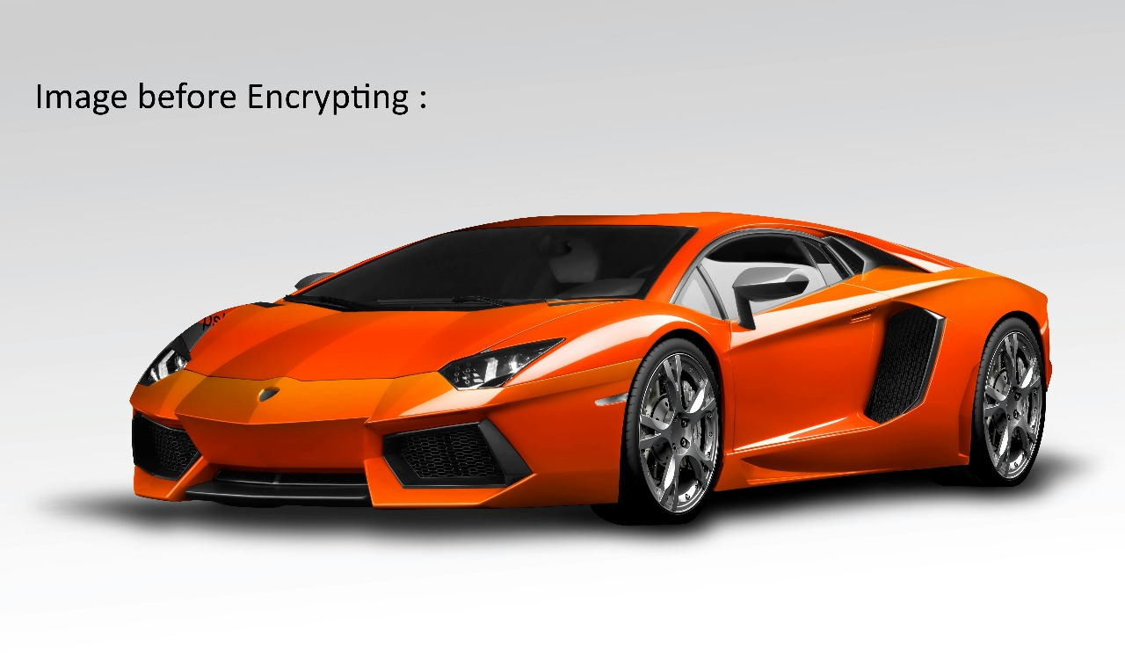
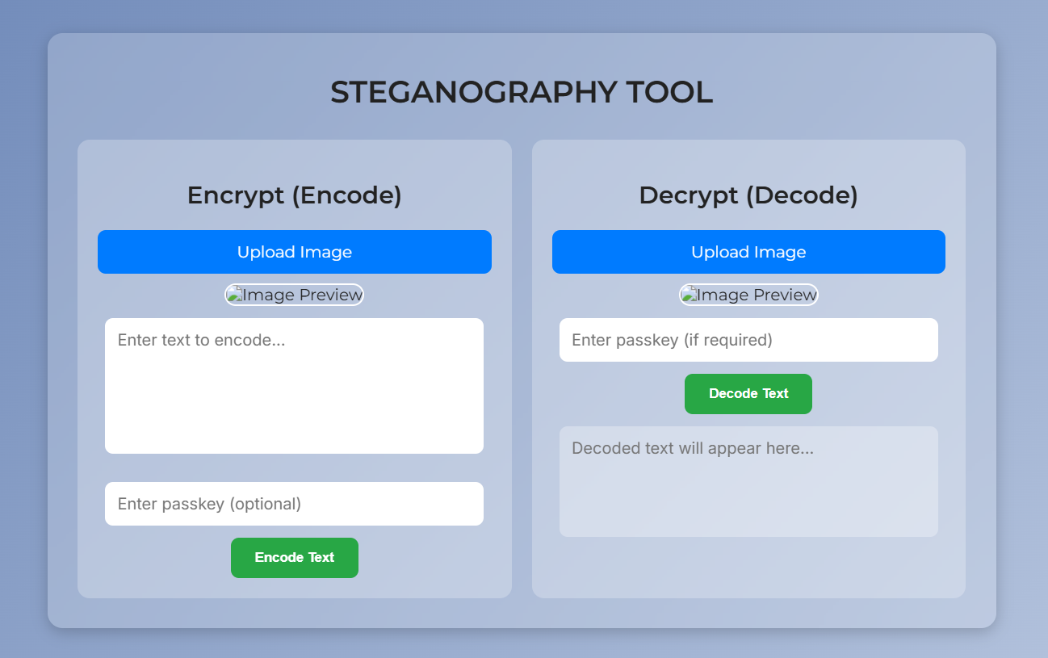

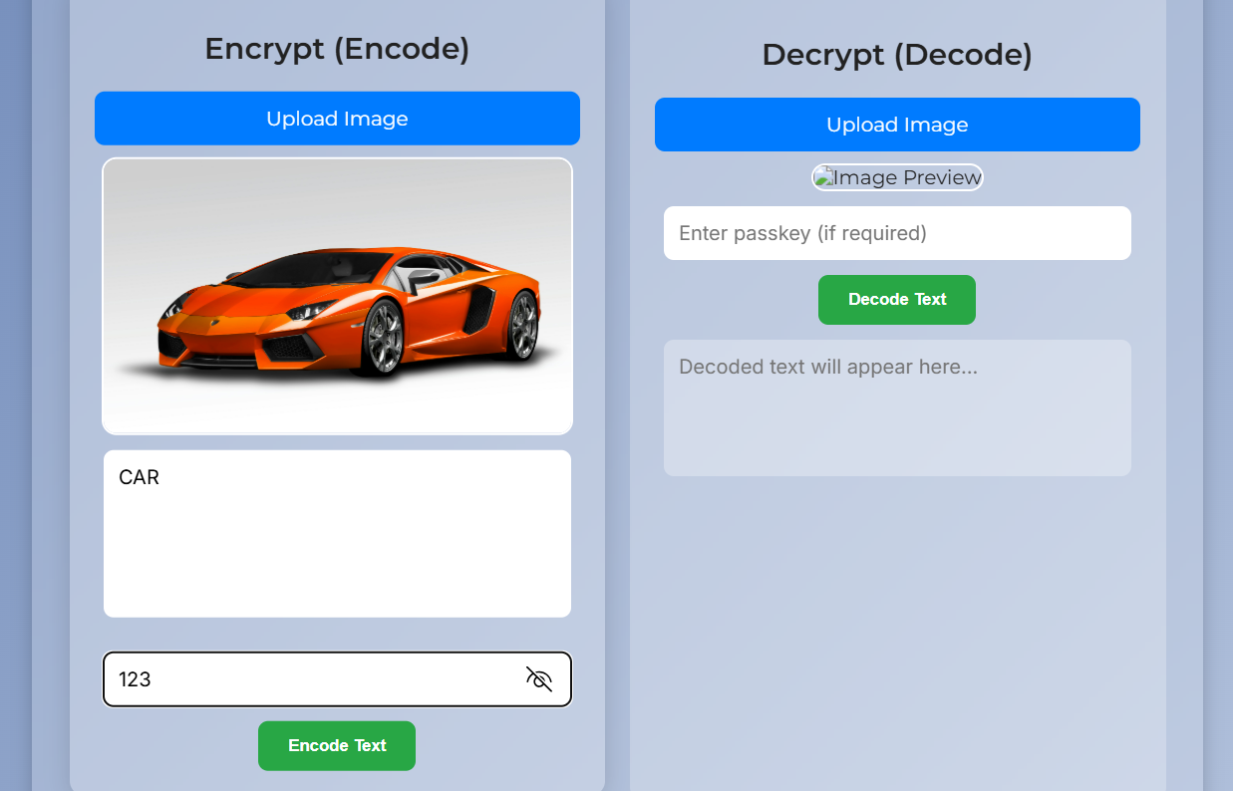
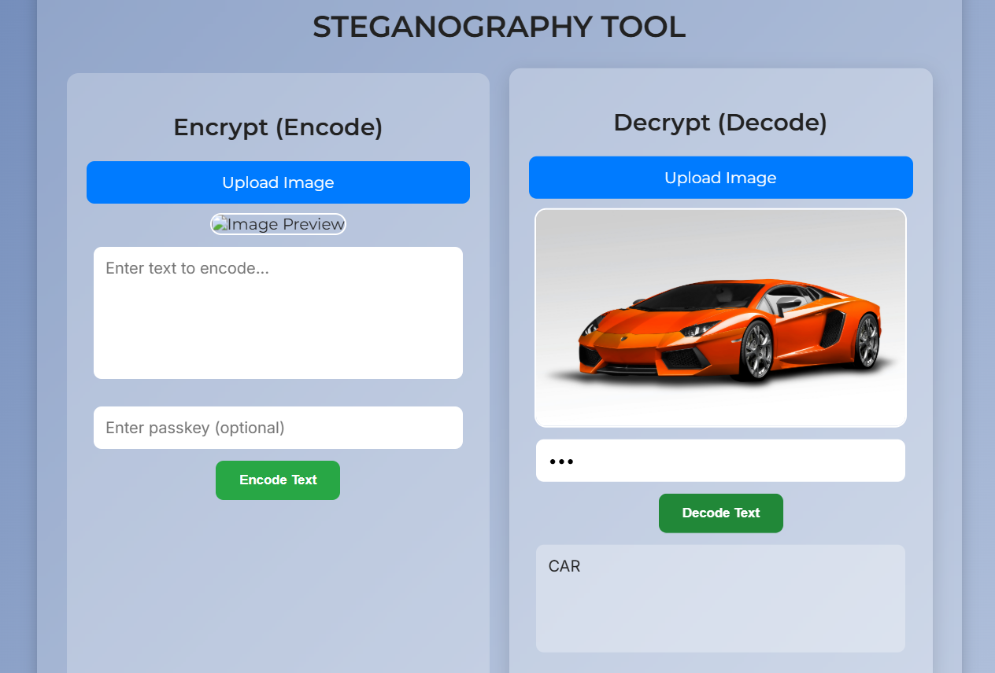
Results

Slide 8
Conclusion
This project provides a secure way to hide messages inside images using image steganography. The hidden text remains invisible to the human eye while allowing easy encoding and decoding. Built with Python for backend processing and HTML, CSS, and JavaScript for the frontend, the tool offers a simple and user-friendly experience. It can be further improved for real-world use, such as secure communication, watermarking, and data protection.

Slide 9
GitHub Link
https://github.com/Harshit-Goel-07/steganography.git

Slide 10
Future scope
🔹 Support for Multiple File Types – Extend functionality to hide messages in audio, video, or PDF files. 🔹 Cloud Integration – Enable secure storage and retrieval of steganographic images on cloud platforms. 🔹 Mobile & Web App – Develop a fully functional web or mobile app for easy access and real-world use.

Slide 11
THANK YOU

